Slide 1

Daily News for Stock Market Prediction
Siqi Jiang
Yanan Liu
Chao Tian

Slide 2
Overview
Introduction
Data Description
Methodology
Conclusion

Slide 3
Introduction
Stock Market Prediction
Technical Analysis
Fundamental Analysis
Notes:
Stock market prediction aims to determine the future movement of the stock value of a financial exchange. The accurate prediction of share price movement will lead to more profit.
Stock market prediction methods are divided into two main categories: technical and fundamental analysis. Technical analysis focuses on analyzing historical stock prices to predict future stock values. Apart from historical stock price data, there are some unquantifiable forces play a major role in the trend of the stock market. The un-quantifiable factors could be a political development, policy changes or some time related event.

Slide 4
Introduction
Negative news
Affected by the news of COVID-19 outbreak all over the world, US stocks experienced four circuit breakers in March 2020.
2020.03.09, the S&P 500 Index fell 7% after the opening, triggering the first circuit breaker.
2020.03.12, the S&P 500 index fell by more than 7% within a short period of time after the opening of the market, which triggered the circuit breaker again.
2020.03.16, the S&P 500 Index dropped 220.60 points, 8.14%, shortly after the opening, triggering the third circuit breaker of the month.
2020.03.18, the S&P 500 Index fell 177.29 points, 7.01%, which triggered the fourth circuit breaker of the month.
Positive news
On November 9, the first trading day when Biden announced his victory, the three major US stock indexes rose sharply. The Dow Jones Industrial Average rose 6.9%. The S&P 500 and Nasdaq rose 7.3% and 9.0% respectively, which are their biggest weekly gains since April this year. The S&P 500 also posted its best weekly performance since 1932.
Notes:
As we can see, Negative news and Positive news can affect stock market.
For example, Affected by the news of COVID-19 outbreak all over the world, US stocks experienced four circuit breakers in March 2020.
On November 9, the first trading day when Biden announced his victory in President election, the three major US stock indexes rose sharply.
So The goal of this project is to predict stock market movement using stock price information and daily news headline. We will analyze word patterns and sentiment of the top headlines to predict the performance of the stock market.

Slide 5
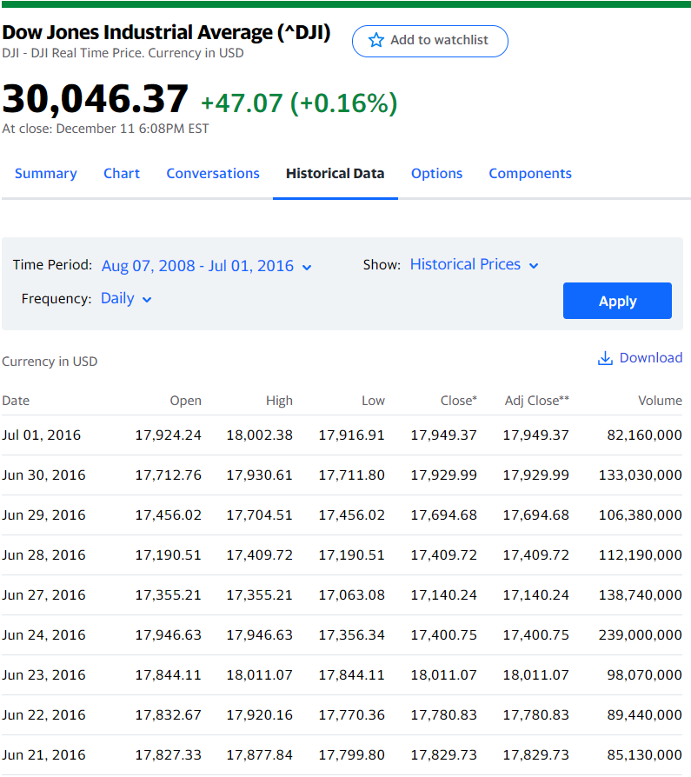
Dataset
Dow Jones Industrial Average (DJIA) daily index values were used. The dataset contains 1989 records with dates ranging from 08-08-2008 to 07-01-2016. On each date, the “open”, “high”, “low”, “close”, “volume”, and “adjusted close” values are recorded.
Notes:
Hi, My name is Chao Tian. I am going to introduce our datasets used in project. First dataset is from …
The picture is showing the detail.

Slide 6

Dataset
Historical news headlines from Reddit World News Channel. They are ranked by Reddit users’ votes, and only the top 25 headlines are considered for a single date.
Notes:
The second dataset is from the ….

Slide 7
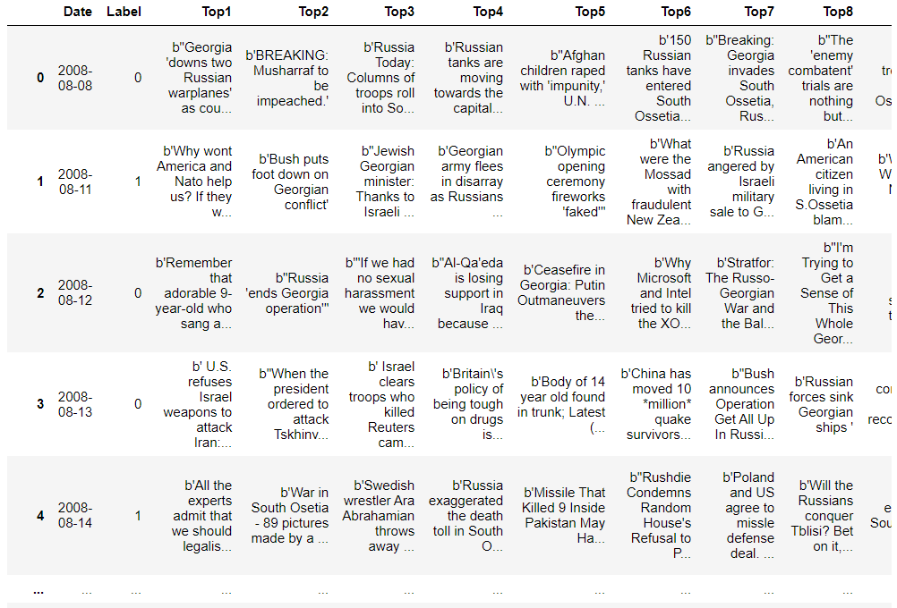
Data Processing
Combined News data and DJIA data:
1. Filling null values in the dataset with median value
2. Two labels:
"1“-- when DJIA Adj Close value rose or stayed as the same;
"0“ -- when DJIA Adj Close value decreased.
The first column is "Date", the second is "Label", and the following ones are news headlines ranging from "Top1" to "Top25".
Notes:
First，we Filling null values in the dataset with median value
And next,
Since the goal of this project is to predict stock market movement using stock price information and daily news headline，we will use the change of “close” value to define the trend of the stock market. To be specific, we replace all the stock data by a “label” feature in the dataset with value “0” if the closing value of DJIA has decreased from previous day’s close, and as “1” if the closing value of DJIA has increased or stayed same as previous day’s close.
After setting labels, we Combined News data and DJIA data. The entire processed dataset consists of 1989 rows, representing the trading days, and 27 columns that represent the features of which 25 are the news headlines (as text), and 1 is the date of the trading day. The feature “label” reflects the rising or falling of the DJIA index.

Slide 8
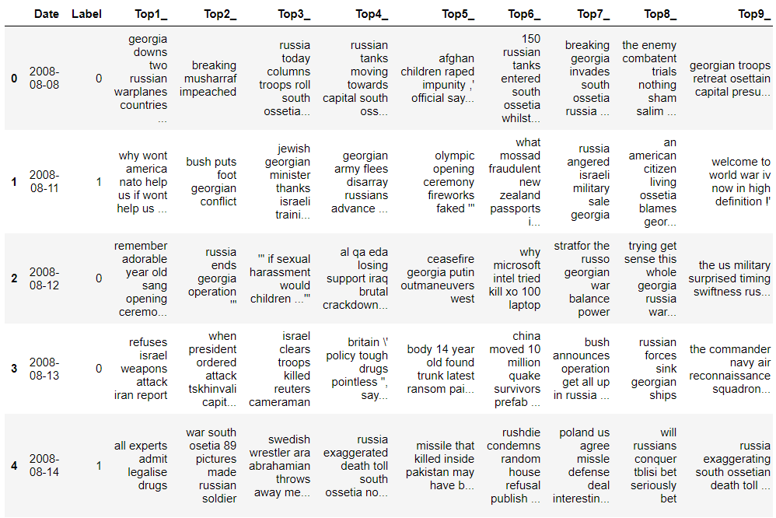
Data Processing
3. Text processing
removed extra characters and meaningless words, such as quotes, extra letters coming between (‘b)
converted the words into lower case letters
b"let's go to mall!! Watch Jim's match”
4. Combining all the headlines into one news
5. Applying TFIDF to transform text into matrix
let go mall !! watch jim match
Notes:
Then, we do some text processing.
The news headline contains some extra information which we do not need or not desirable for text processing, such as letter b, double quotes, single quote, upper case letters. All of them should be removed in order to further process the text and apply our text classification models.
So we removed extra characters and meaningless words, such as quotes, extra letters coming between (‘b). Then we converted the words into lower case letters.
You can see the sample news on the left concern.
The dataset after processing is on the right.
Finally, we combined all the sentences or headlines in a row, and we use TFIDF to transform text into matrix.

Slide 9
Basic Model
Model | Accuracy
Logistic | 0.507537
RandomForest | 0.502513
MultinomialNB | 0.507538
XGBoost | 0.50
Notes:
According to this table, we can find that, all of these four basic machine learning models, the accuracy rate is around 50%. The performance of these 4 classifiers is not very different.

Slide 10
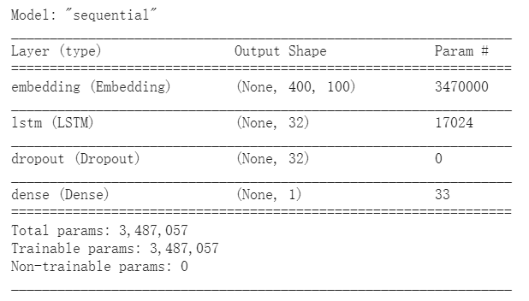
Advanced Model: LSTM
Notes:
In this model, I decide the max_lenth equal to 400, and the embedding layer’s output dim equal to 100. And I also add a dropout layer to prevent overfitting. This picture is the summary of LSTM model. And about the result, it get 52% accuracy. A little better than basic models.

Slide 11
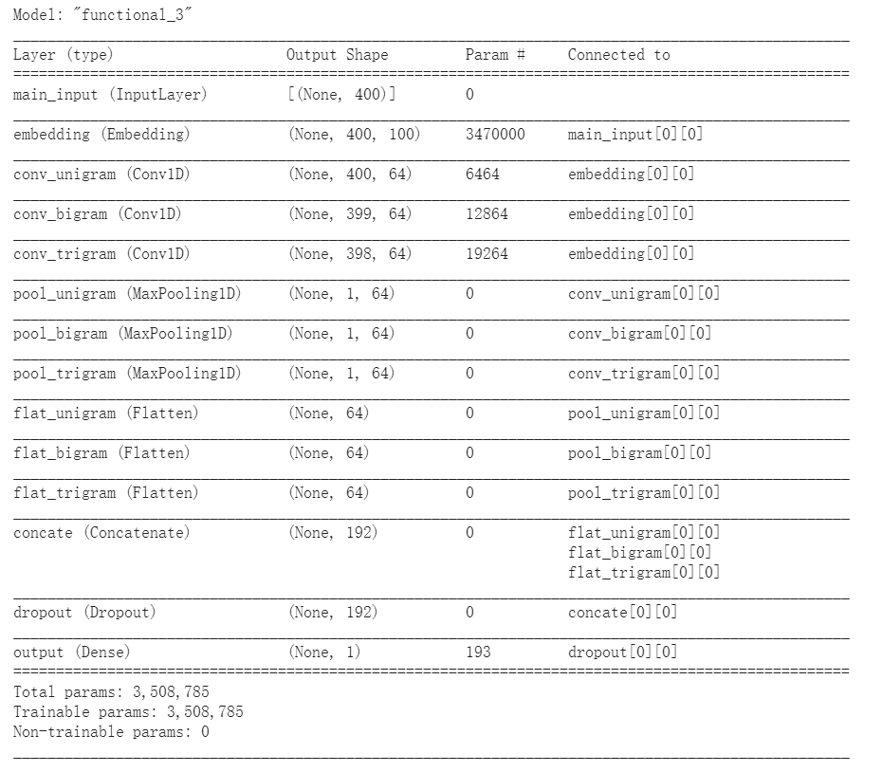
Advanced Model:CNN
Notes:
For CNN model, it most commonly applied to analyzing visual imagery. But Inspired by class lab, we decide to try to use this model to deal with text classification problem. Technically, deep learning CNN models to train and test, each input will pass it through a series of convolution layers with filters (Kernals), Pooling, fully connected layers (FC) and apply Sigmiod function to classify an object with probabilistic values between 0 and 1. The accuracy is also about 0.52

Slide 12
Conclusion
Using machine learning and deep learning prediction model, we predict the ‘adj close price’ of stock will up or down in the future.
In these models, we verify that positive and negative words are making some sense by using tf-vectorizer.
Finally, we compare and analyze the performance of these prediction model. Deep learning models generally perform slightly better
Future work : try to build BERT model, it maybe will have better performance
Notes:
After dealing and analyzing the top25 daily news from 08-08-2008 to 07-01-2016, we can easily find these existing relations between media news and stock market movement. And also, In these models, we use tfvectorizer to verify that positive and negative words are making some sense. At the end, comparing to basic models, the deep learning model have better performance.

Slide 13
THANK YOU

